Slide 1




RADS Workshop Nathia Gali, Pakistan
Imperial College London
Nathan Green, David Jorgesen

Slide 2
Introductions

Slide 3





Our standing
Times Higher Education World University Rankings 2019: 9th overall, 3rd in UK
Times Higher Education World’s Most International Universities 2019: 9th in the world
QS World University Rankings 2019: 8th in the world
Research Excellence Framework (REF): 1st for high impact research of any UK university
Reuters Europe’s Most innovative universities 2019: 1st in UK, 3rd in Europe
The Guardian University Guide 2019: 1st for Career Prospects

Slide 4

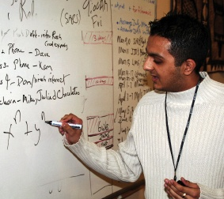

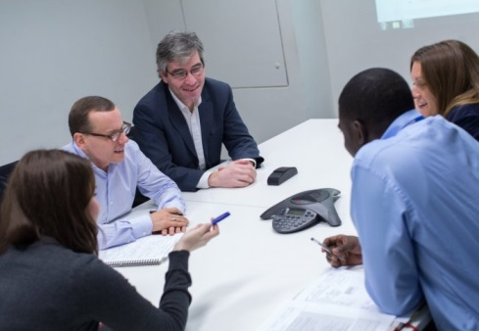
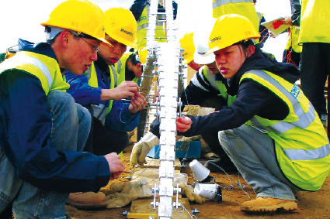
Our people
Students
17,054 full-time (2017–18)
9,767 – undergraduate
3,812 – taught postgraduate
3,475 – research postgraduate
Students from 132 countries
Staff
3,765 academic and research staff
3,940 support staff
Alumni
Over 190,000 alumni

Slide 5
Workshop content
Comfortably use RStudio (a graphical interface for R)
Fluently interact with R using Rstudio
Become familiar with R syntax
Understand data structures in R
Inspect and manipulate data structures
Install packages and use simple functions in R
Visualize data
using ggplot2

Slide 6
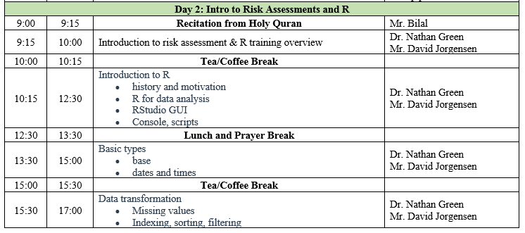
Timetable

Slide 7
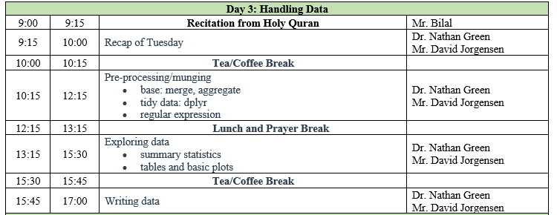

Slide 8
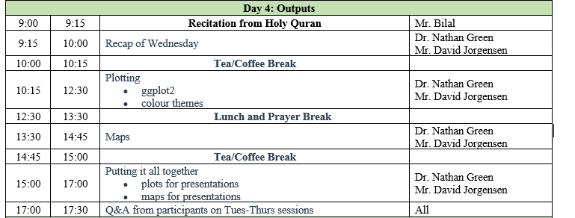

Slide 9
Course website
https://n8thangreen.github.io/Pakistan-workshop-site/

Slide 10
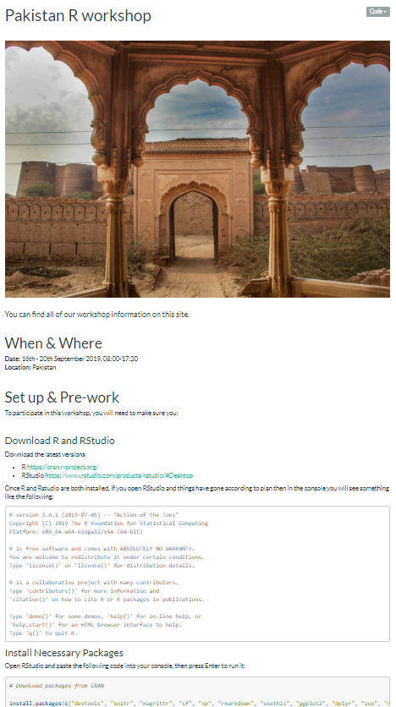

Slide 11
Code of conduct
Please ask questions
Be curious
Make mistakes
Practices makes perfect
Have fun!

Slide 12
